Slide 1






Baderia Global Institute of Engineering and Management, Jabalpur, Madhya Pradesh 482002
Problem Statement: AI-Powered Language Tutor – Build an AI tutor that helps students learn new languages through real-time translation, quizzes, and pronunciation feedback using Azure Translator API.
Team Name: TechMatrix Solvers
Team Leader Name:
Abhay Gupta
Institute Name: Shri Ram Institute of Technology Jabalpur
Theme Name: AI MultiLingo
Team Leader Email ID: contact2abhaygupta@gmail.com

Slide 2





Team TechMatrix Solvers
Mayank Das Bairagi
Aditya Vishwakarma
Aditi Lakhera
ABHAY GUPTA
BrahmaX 1.0

Slide 3


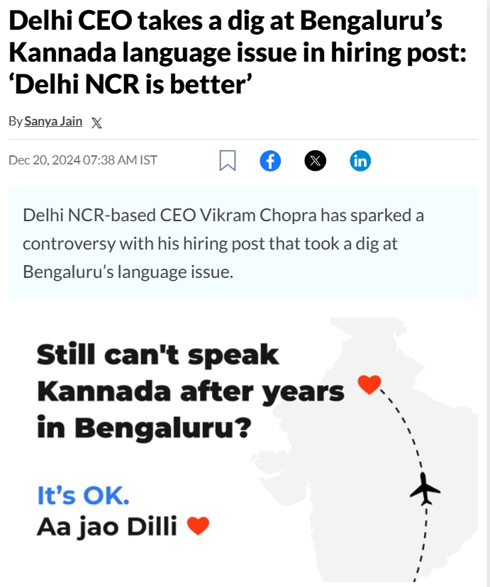
Problem Statement
TechMatrix Solvers
Problem Statement EdTech E1. AI tutors and content recommendation systems: Intelligent tools that provide personalized guidance and resources, enhancing the learning process. SOLUTION AI-Powered Language Tutor: Develop an AI tutor focused on language acquisition. Leveraging the Azure Translator API, this tool will assist students by offering real-time translation, creating interactive quizzes to test comprehension, and providing instant pronunciation feedback.
BrahmaX 1.0

Slide 4
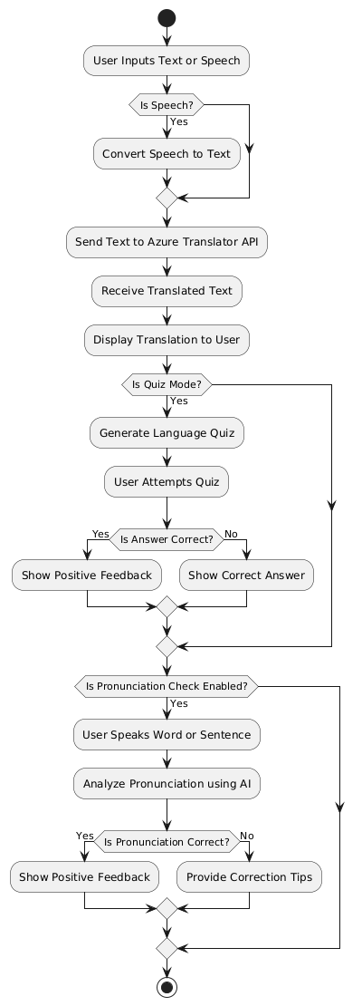
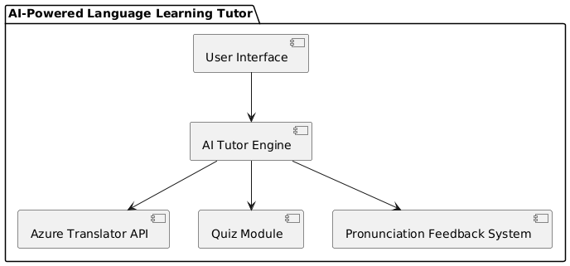
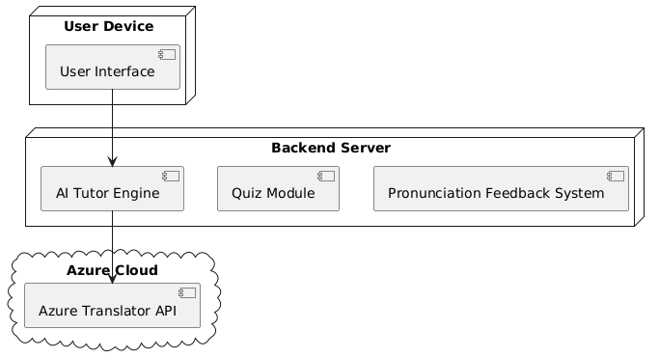
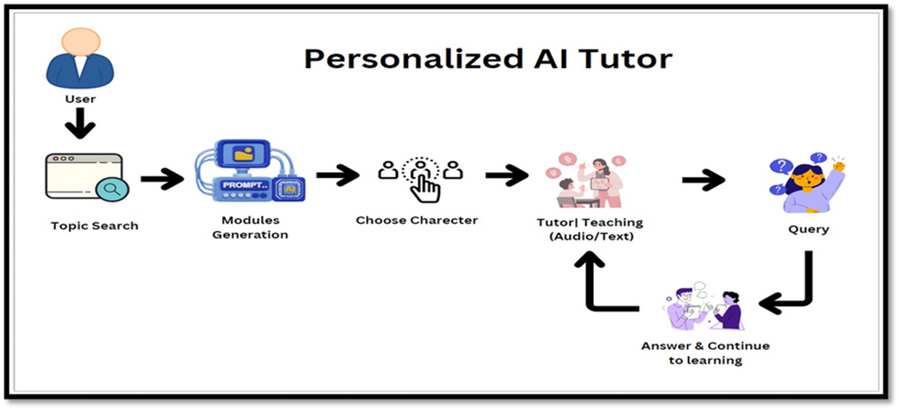
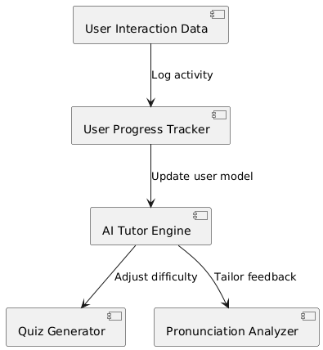
Technical Solution
TechMatrix Solvers
Supporting Images/Flowchart
Idea Approach
BrahmaX 1.0

Slide 5
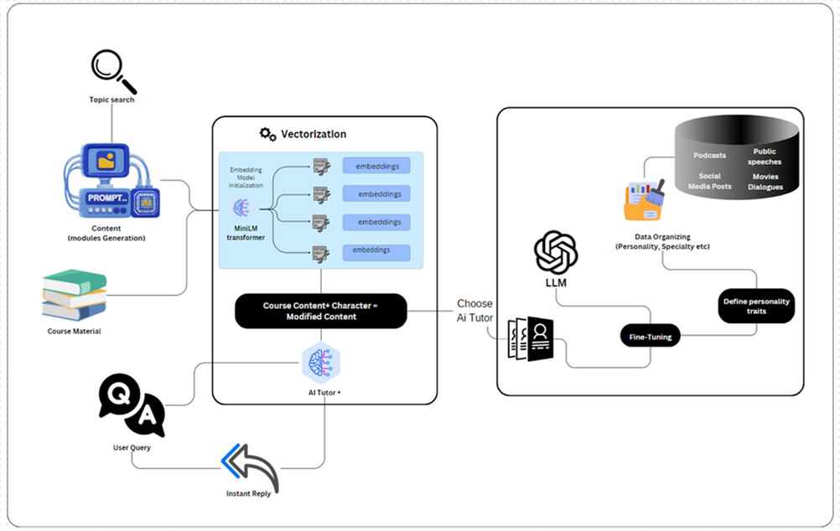
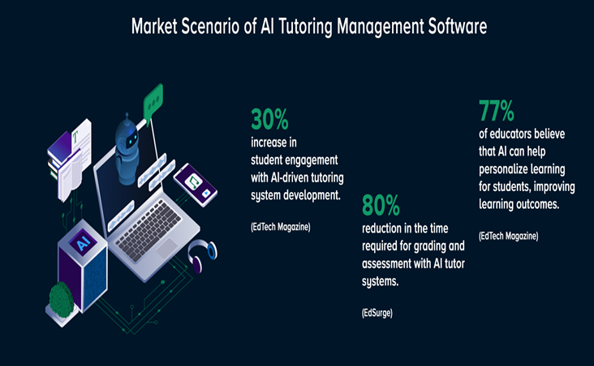

Use Cases And Market Reach
TechMatrix Solvers
Abiads/AI-MultiLingo: TechMatrix Solvers
BrahmaX 1.0

Slide 6
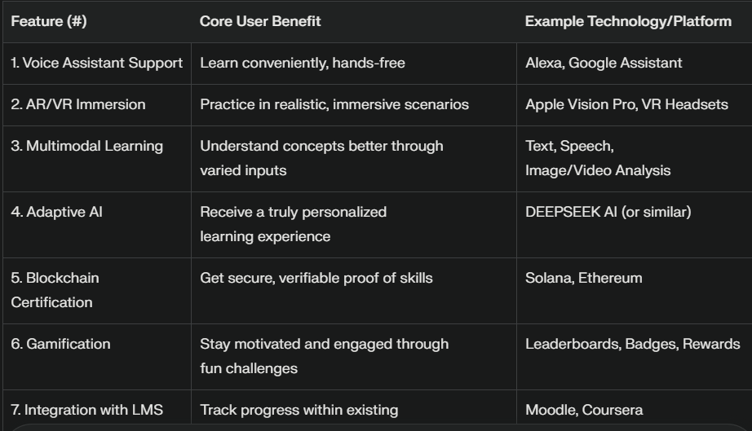






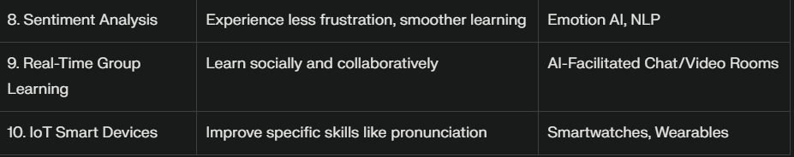
Future Integration
TechMatrix Solvers
BrahmaX 1.0

Slide 7

Target language: Japanese
Prior knowledge: I've done 100 lessons on duolingo, so I know words like hello, goodbye, some sentences like where is, my name is, some colors, how to say where and there
Target knowledge: Enough to be able to enjoy a three week vacation`;
Why Azure AI Speech?
Out of the text-to-speech solutions I tried, this was the only one I was able to get to produce good bilingual results within a single paragraph, by specifying language with the Speech Synthesis Markup Language. As a bonus, generating all the lessons during testing and finalization (several hundred lessons, 4-5 hours of conversation) was well within the Azure free tier
TechMatrix Solvers
Watch The Video
Credits Abhay Gupta TechMatrix Solvers Team Lead
This is Embedded Video in PPTX Turn on Slideshow Click on Above video
BrahmaX 1.0

